Slide 1


Winner-takes all Learning Rule
=============================================================================
WWW.THEMLLABS.COM || contact@themllabs.com || Phone : 91-7338339898, 91-6362546088

Slide 2
Agenda
Winner-takes all Learning
Circuit example
Two-input CMOS winner take all circuits
=============================================================================
WWW.THEMLLABS.COM || contact@themllabs.com || Phone : 91-7338339898, 91-6362546088

Slide 3
Winner take all learning rule
Winner-take-all learning algorithm is normally applied in computational modes of neural network.
Neuron in a layer compete with each other neurons for activation
It can be implemented using different types of neural network models, including continuous and spiking networks.
=============================================================================
WWW.THEMLLABS.COM || contact@themllabs.com || Phone : 91-7338339898, 91-6362546088

Slide 4
Winner-take-all networks used in distributed decision-making or active selection in the cortex (Ex. Hierarchical models of vision).
It’s operation is computationally powerful compared to other nonlinear operations.
There can be exactly k neurons become active, this principle is called k-winner-takes-all.
=============================================================================
WWW.THEMLLABS.COM || contact@themllabs.com || Phone : 91-7338339898, 91-6362546088

Slide 5
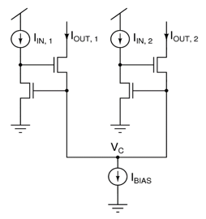
Circuit example
A simple CMOS winner-take-all circuit is shown below. The circuit was proposed by Lazzaro et al. in 1989.
=============================================================================
WWW.THEMLLABS.COM || contact@themllabs.com || Phone : 91-7338339898, 91-6362546088

Slide 6
In the circuit, there is only two inputs(llN,1 and llN,2), the circuit can be extended to multiple inputs.
It operates on continuous-time input signals in parallel, using two resistors per input.
The largest of the input currents sets the common potential VC.
=============================================================================
WWW.THEMLLABS.COM || contact@themllabs.com || Phone : 91-7338339898, 91-6362546088

Slide 7
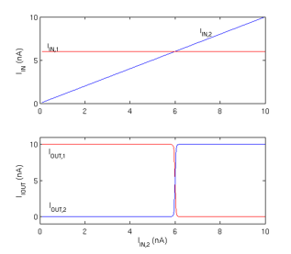
Two input CMOS winner take all circuit
CMOS winner-take-all circuit in the two-input case is shown below.
=============================================================================
WWW.THEMLLABS.COM || contact@themllabs.com || Phone : 91-7338339898, 91-6362546088

Slide 8
In the top subplot, the input IIN,1 was fixed at 6nA and IIN,2 was increased from 0 to 10nA linearly.
In the bottom subplot, the output corresponds to larger of the inputs carries the entire bias current (10nA), forcing other input current nearly to zero.
=============================================================================
WWW.THEMLLABS.COM || contact@themllabs.com || Phone : 91-7338339898, 91-6362546088

Slide 9
Thank you
=============================================================================
WWW.THEMLLABS.COM || contact@themllabs.com || Phone : 91-7338339898, 91-6362546088

